Slide 1
DATA SCIENCE & DIGITAL IMAGES
Recognition, Generation & Conversion
Presented By,
AJAY T SHAJU
S4 AD | ROLL NO: 04

Slide 2
CONTENTS
Image Recognition
Why Image Recognition?
How Computer recognize images
Image to Text
OpenCV
Text to Image
DALL·E 2
Our Focus
Knowledge Space
Websites
YouTube channels & Videos

Slide 3
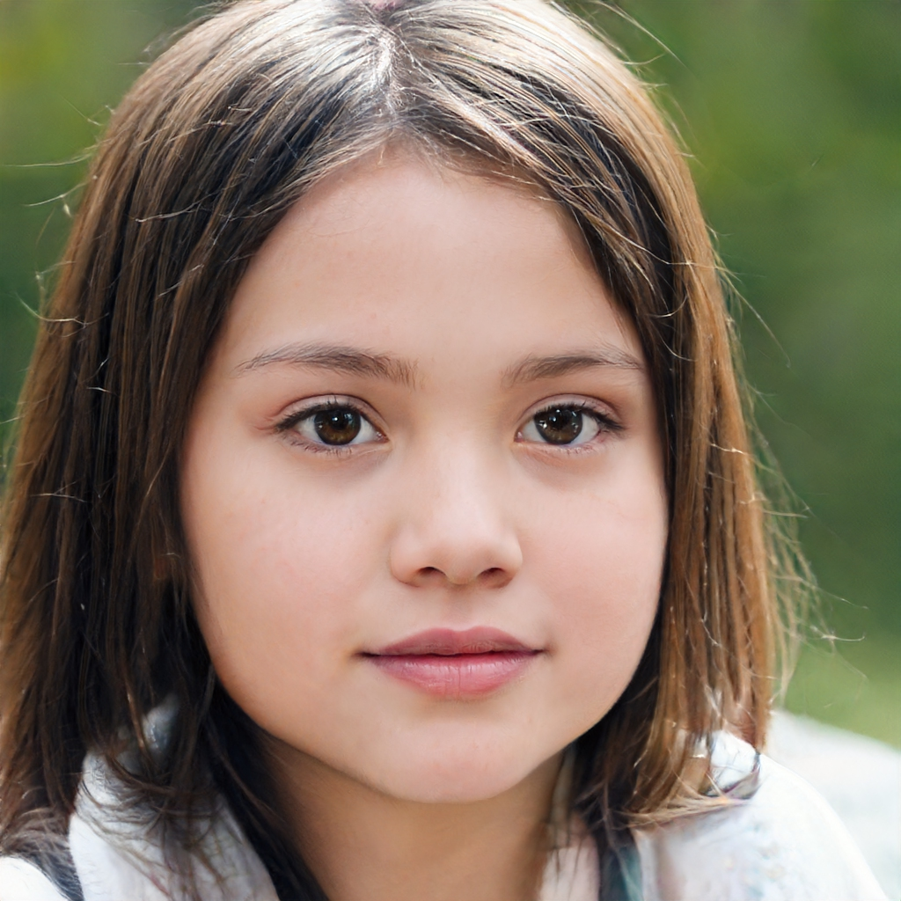
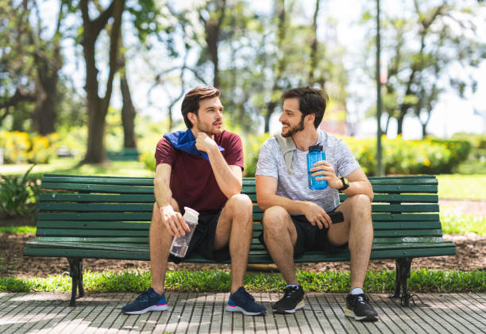

Slide 4
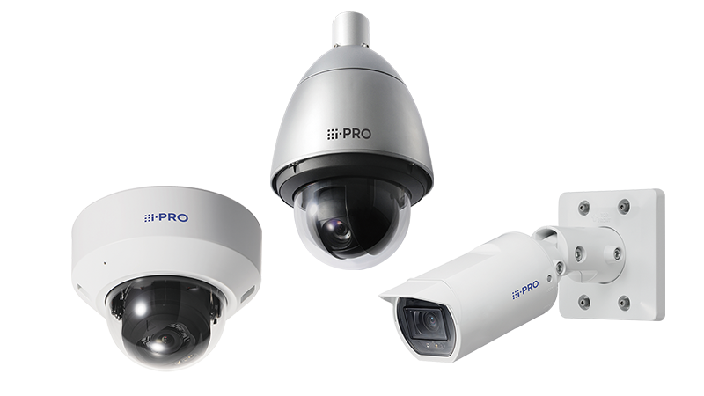
WHY IMAGE RECOGNITION?
What if Security cameras have Image Recognition?

Slide 5
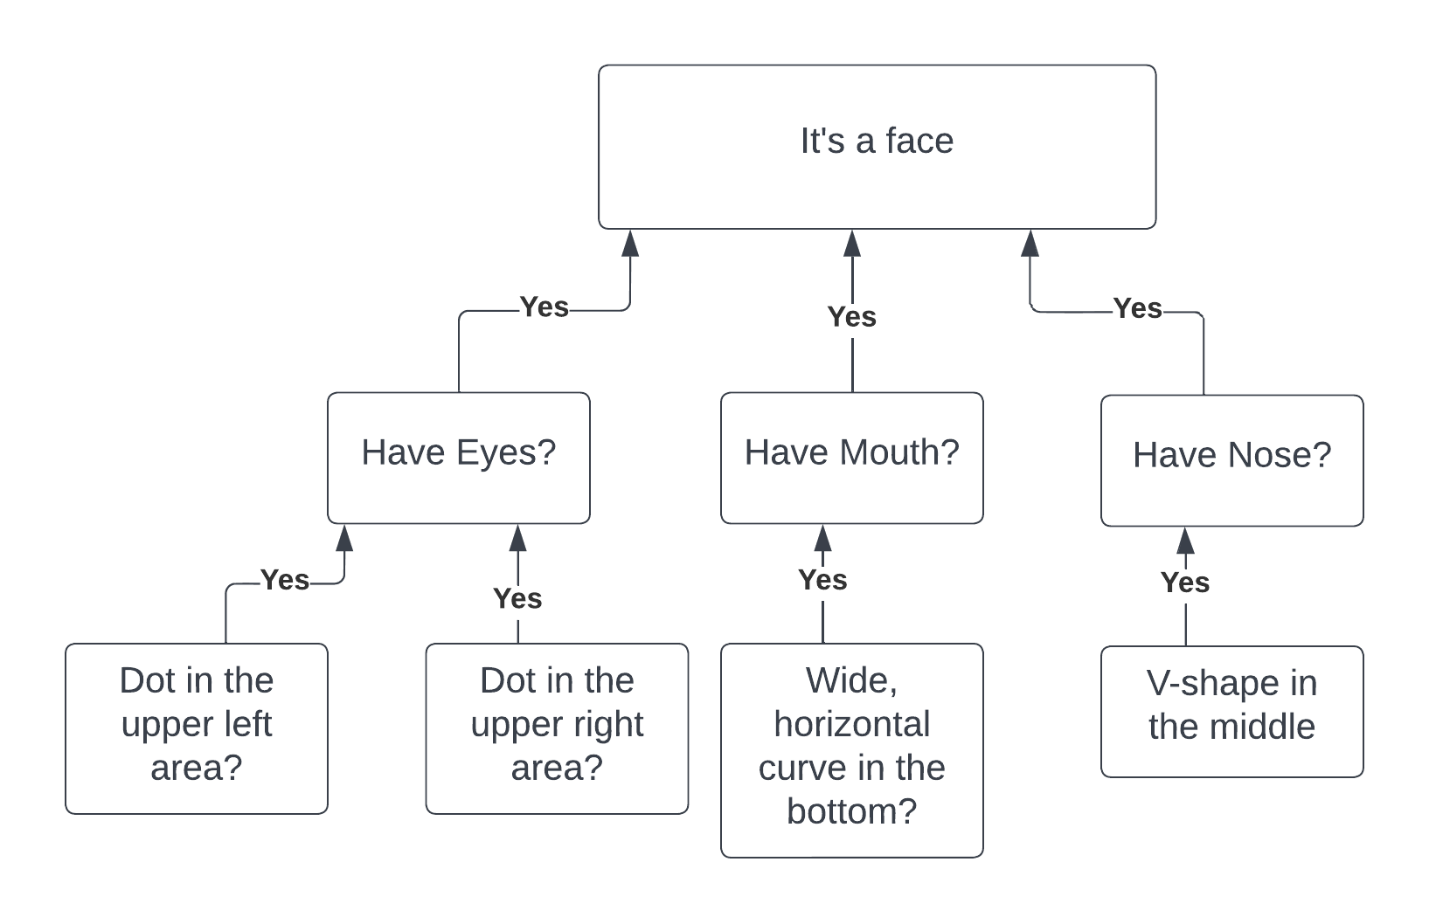
Face Recognition Basic Flowchart

Slide 6
Detection: Locating an object in an image is called detection. Once the object is found, a bounding box is put around it Classification: Process of determining the class or category of an image. Ex: ‘Dogs’, ‘Human’ Tagging: Similar to classification but aims for better accuracy. Ex: Image of a park, it can have tags like "dogs", "cats", "humans", and "trees" Segmentation: The detection task that attempts to locate objects in an image to the nearest pixel is called segmentation. It's helpful in situations where precision is critical.
How does Image Recognition work?

Slide 7
PHOTOGRAPHS ARE THE FRAMED MEMORIES - ANONYMOUS
Two young friends, discussing some events while sitting in a park bench, which is made for children.

Slide 8
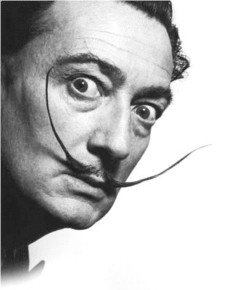
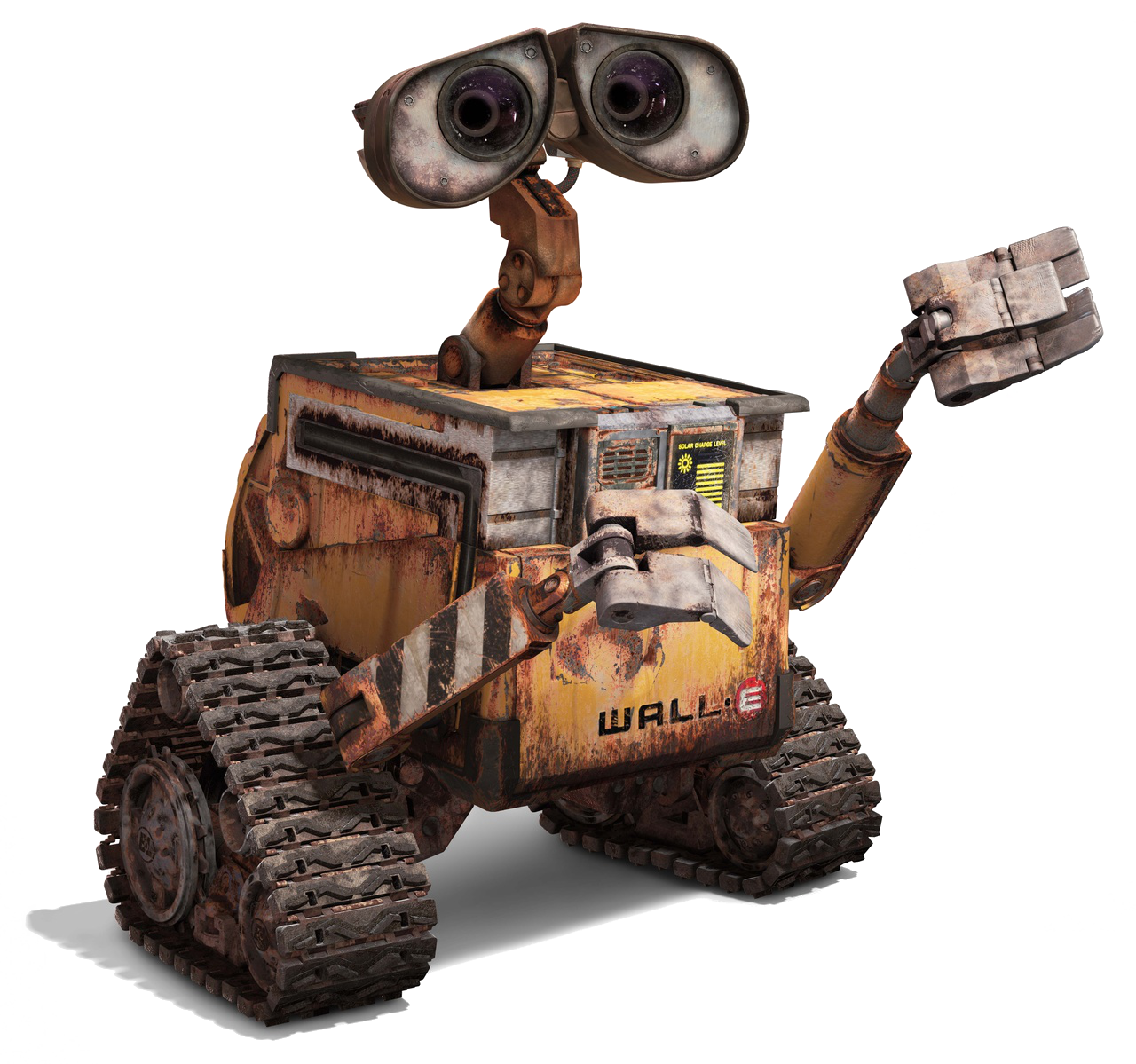
SALVADOR DALÍ + WALL-E DALL·E 2
A new AI system that can create realistic images and art from a description in natural language.

Slide 9
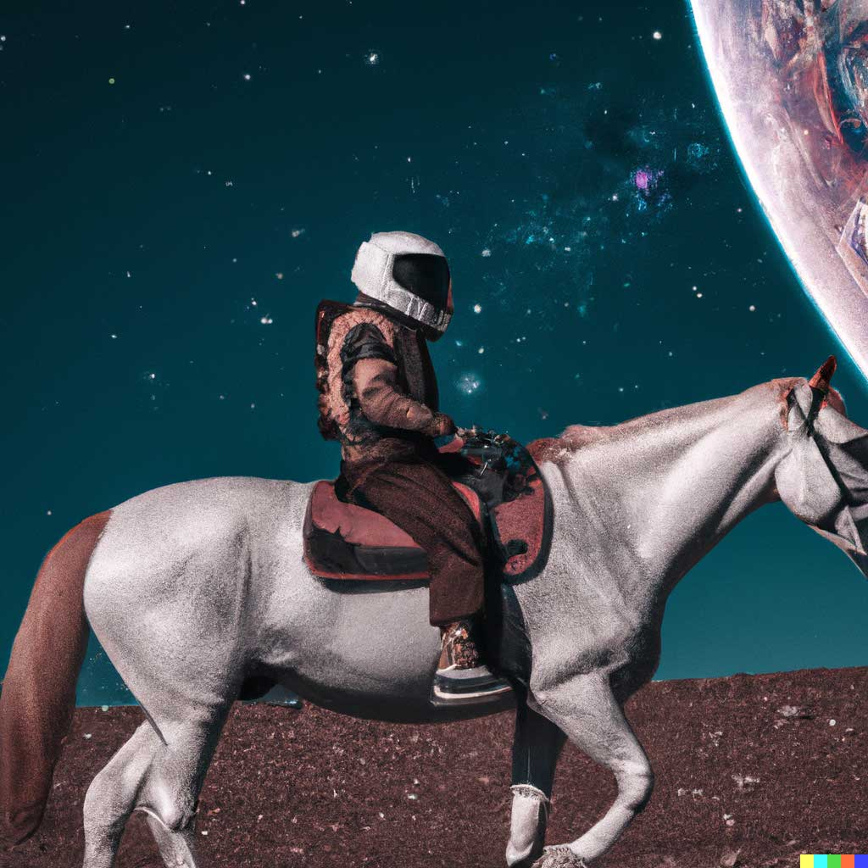
An astronaut riding a horse on another planet
astronaut
riding a horse
planet
riding
horse

Slide 10
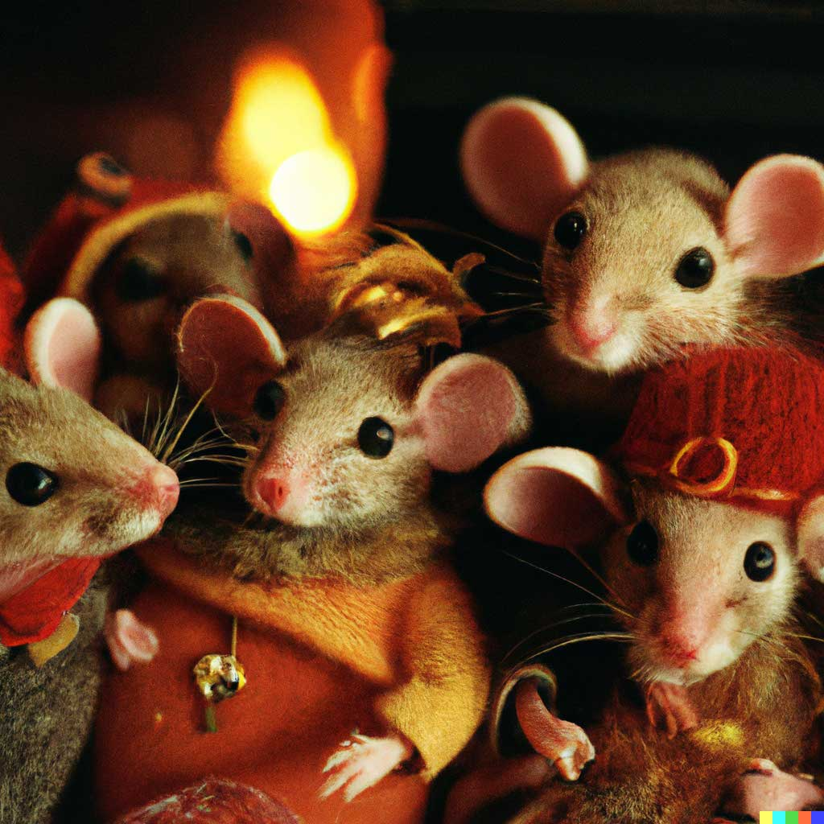
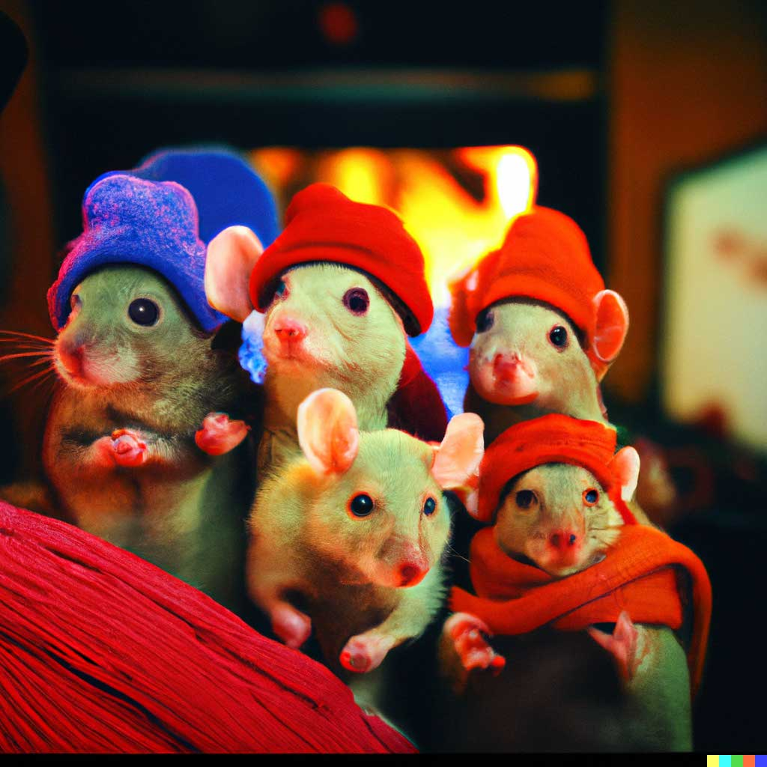
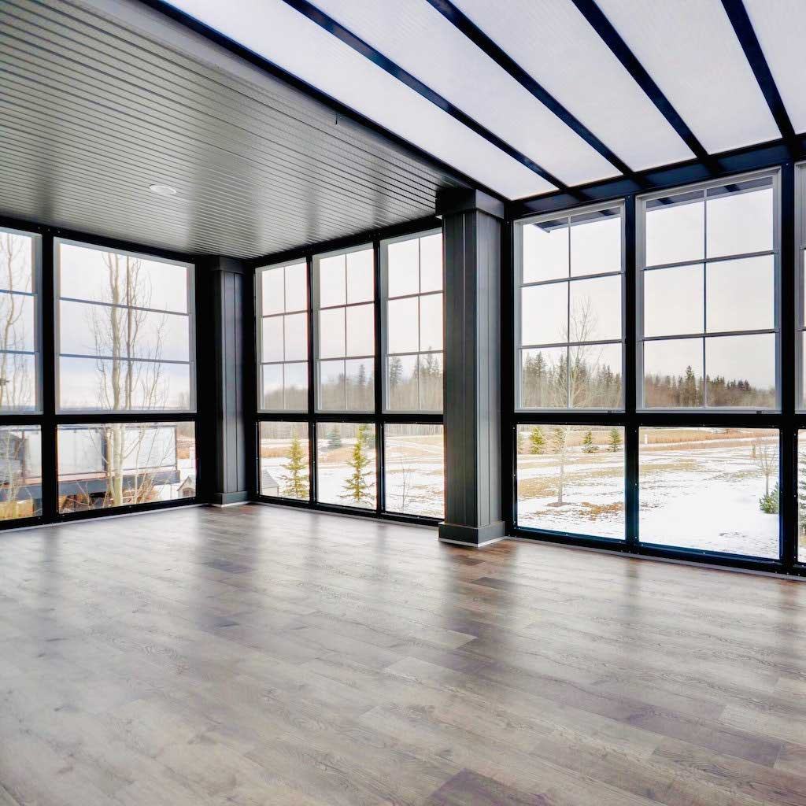
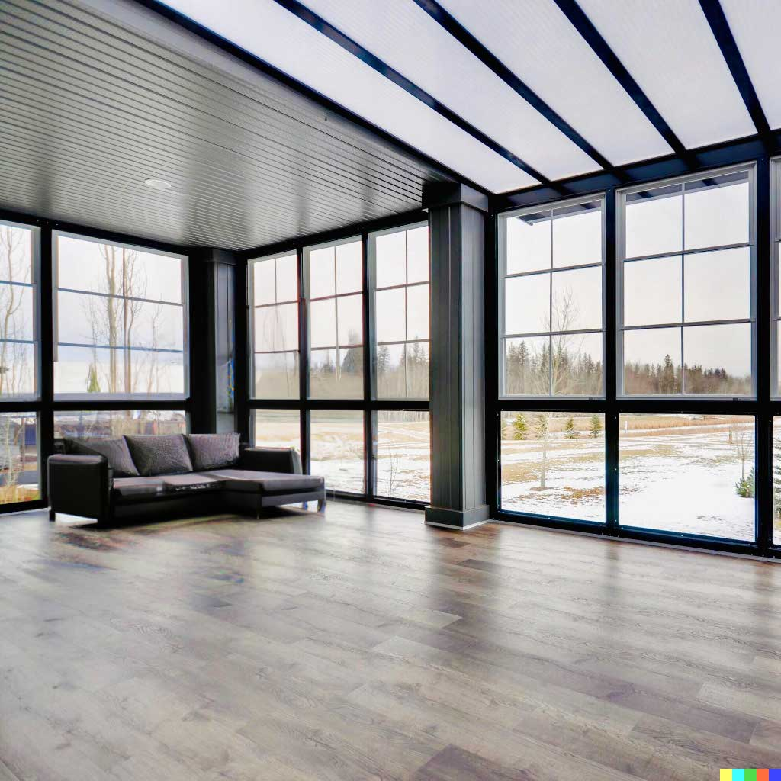
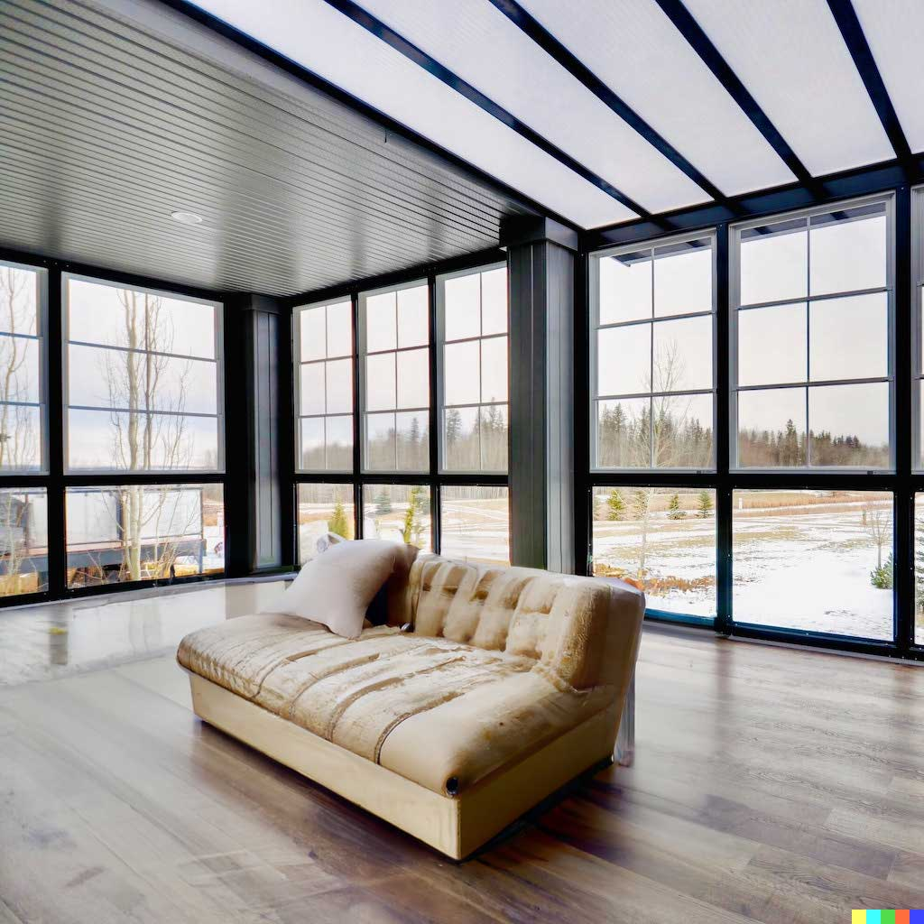
Variation & Edits in Images
Original Image
DALL·E2 Image

Slide 11
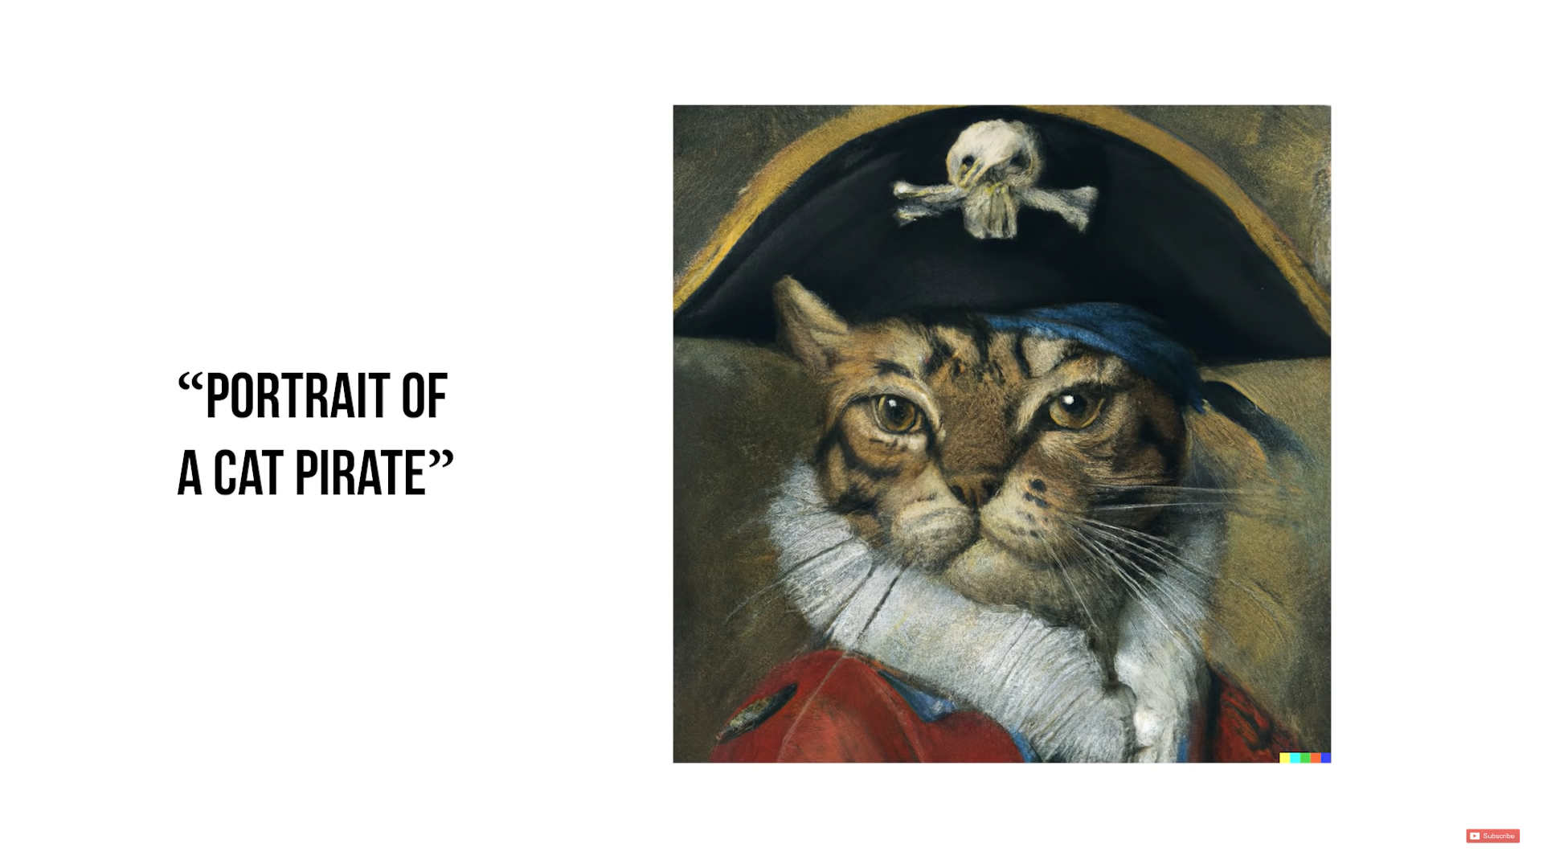
Portrait of a Cat Pirate

Slide 12
DALL·E 2
AIM FOR THE FUTURE
Understanding World Around Us
Developing AI Systems
Benefit for Humanity

Slide 13
Advantages
Open source
Empower people to express themselves creatively
An introduction to Image processing, NLP etc…
Disadvantages
Unwanted content creation, eg: a man sleeping in a pool of red liquid.
Copyrighted contents, eg: McDonald’s Joker wearing KFC merchandise.
More Info on DALL·E 2
DALL·E 2 Website: openai.com/dall-e-2

Slide 14
OUR FOCUS AREAS
Beginner
Make a program to recognize an image.
Make an image out of texts.
Intermediate
Make a program to generate age changes.
Expert
Teach a machine to make strategic decisions
Ultimate
Make a Full Length Movie out of texts & images

Slide 15
CHALLENGES FOR IMAGE RECOGNITION
Lot of images are needed to train the network.
Complicated structure of the network , especially when color is used.
Lot of time and computational power.
Big Database to store these images

Slide 16
Knowledge Space
WEBSITES
Intro to Images: bit.ly/ImgProcessing
OpenAI: openai.com
This X does not exist: thisxdoesnotexist.com
Google X Company: x.company
Nvidia Reasearch: nvidia.com/en-us/research
NVLabs GitHub: github.com/NVlabs
Latest StyleGAN: github.com/NVlabs/stylegan3
Research paper archives: arxiv.org
CHANNELS & VIDEOS
DALL·E 2: youtube.com/watch?v=qTgPSKKjfVg
MKBHD: youtube.com/watch?v=yCBEumeXY4A
Branch Education: youtube.com/c/BranchEducation
Coding: youtube.com/c/Freecodecamp
Neural Network Animation: youtube.com/watch?v=3JQ3hYko51Y
Neural Network Detailed: youtube.com/watch?v=aircAruvnKk
USEFUL AI SOFTWARES: Grammarly, WordTunes
Image sources: DALL·E 2 website, thispersondoesnotexist.com, Google Images & YouTube

